Slide 1
Java Programming
UNIT:IV

Slide 2
EVENT HANDLING
2
Notes:
2

Slide 3
Delegation Event Model:
The concept of delegation event model is: a source generates an event and sends it to one or more listeners. The listener waits until it receives an event, once received the listener processes the event and then returns.
In the delegation event model, listeners must register with the source to receive an event notification.
Three points to notice here:
Events
Event Sources
Event listeners
3

Slide 4
Events:
An event is an object that describes a state change in a source.
Some activities that cause events to be generated are:
pressing a button
entering a character via keyboard
clicking mouse
selecting a checkbox …
4

Slide 5
Event Sources:
A source is an object that generates an event.
Source may generate more than one type of event.
A source must register listeners in order for the listeners to receive notifications about the event.
5

Slide 6
Event Listeners:
A listener is an object that is notified when an event occurs.
Every listener has two requirements:
It must register with one or more sources.
It must implement methods to receive and process events.
6

Slide 7
Event Classes:
There are many events generated by many sources.
So, we begin with event classes:
At the root of Java event class hierarchy is EventObject class in java.util.
It is the superclass for all events.
It contains two methods:
Object getSource( )
String toString( )
The class AWTEvent in java.awt package is subclass of EventObject and is superclass of all AWT-based events used by the delegation event model.
7

Slide 8
Event Classes:
The package java.awt.event defines several types of events generated by various sources.
Event Class | Description (Generated when)
ActionEvent | A button is pressed, a list item is double clicked, menu selected
AdjustmentEvent | Scroll bar is manipulated
ComponentEvent | Component is hidden, moved, resized or becomes visible
ContainerEvent | Component is added to or removed from a container
FocusEvent | Component gains or loses keyboard focus
ItemEvent | Checkbox or list item clicked, choice selection is made
KeyEvent | Input is received from the keyboard
MouseEvent | Mouse is dragged, moved, clicked, pressed, released, enters or exits a component
TextEvent | Value in text area or text field is changed
WindowEvent | Window is activated, closed, deactivated, opened or quit
8

Slide 9
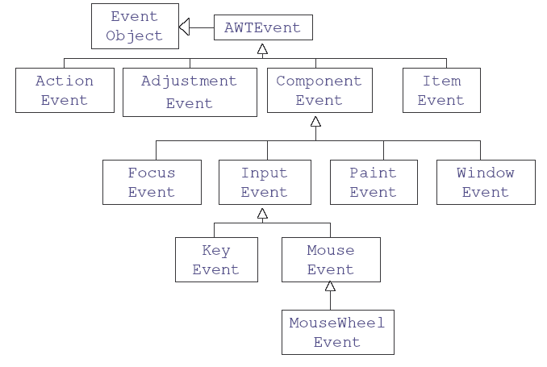
Event class hierarchies:
9

Slide 10
Event Source Classes:
Event | Source Description
Button | Generates action events when the button is pressed.
Checkbox | Generates item events when the check box is selected or deselected.
Choice | Generates item events when the choice is changed.
List | Generates action events when an item is double-clicked; Generates item events when an item is selected or deselected.
Menu Item | Generates action events when a menu item is selected; generates item events when a checkable menu item is selected or deselected.
Scrollbar | Generates adjustment events when the scroll bar is manipulated.
Text components | Generates text events when the user enters a character.
Window | Generates window events when a window is activated, closed, deactivated, deiconified, iconified, opened, or quit.
In addition to these graphical user interface elements, other components, such as an applet, can generate events
10

Slide 11
Event Listener Interfaces:
Listeners are created by implementing one or more of the interfaces defined by the java.awt.event package. When an event occurs, the event source invokes the appropriate method defined by the listener and provides an event object as its argument.
Interface
ActionListener
AdjustmentListener
ComponentListener
ContainerListener
FocusListener
ItemListener
KeyListener
MouseListener
MouseMotionListener
MouseWheelListener
TextListener
WindowFocusListener
WindowListener
11

Slide 12
Handling Mouse Events:
Event Sources Applet or Frame
Events MouseEvent
Event listeners MouseListener
MouseMotionListener
12

Slide 13
MouseEvent class:
MouseListener interface:
int getX( )
int getY( )
Point getPoint( )
void translatePoint(int x, int y)
int getClickCount( )
boolean isPopupTrigger( )
void mouseClicked(MouseEvent me)
void mouseEntered(MouseEvent me)
void mouseExited(MouseEvent me)
void mousePressed(MouseEvent me)
void mouseReleased(MouseEvent me)
MouseMotionListener interface:
void mouseDragged(MouseEvent me)
void mouseMoved(MouseEvent me)
13

Slide 14
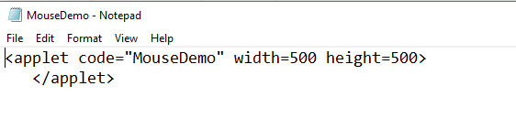
Handling Mouse Events:
import java.applet.*;
import java.awt.*;
import java.awt.event.*;
/* <applet code="MouseDemo" width=500 height=500>
</applet> */
public class MouseDemo extends Applet
implements MouseListener
{
String msg="Hello";
public void init( ) {
addMouseListener(this);
}
public void mouseClicked(MouseEvent me)
{
msg="Clicked";
repaint( );
}
public void mouseEntered(MouseEvent me)
{
msg="Entered";
repaint( );
}
p v mouseExited(MouseEvent me) {
msg="Exited";
repaint( );
}
p v mousePressed(MouseEvent me) {
msg="Pressed";
repaint( );
}
p v mouseReleased(MouseEvent me) {
msg="Released";
repaint( );
}
public void paint(Graphics g) {
g.drawString(msg,50,50);
}
}
14

Slide 15

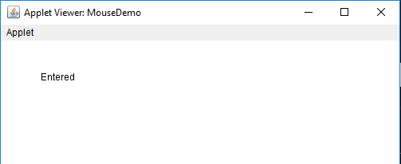
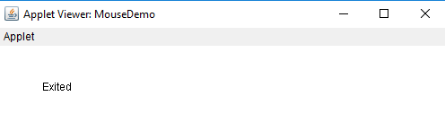
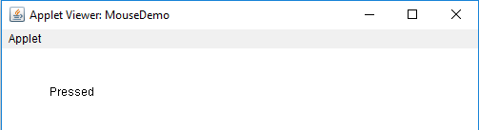

Slide 16
Handling Key Events:
Event Sources Applet or Frame
Events KeyEvent
Event listeners KeyListener
16

Slide 17
KeyEvent class:
char getKeyChar( )
int getKeyCode( )
KeyListener interface:
void keyPressed(KeyEvent ke)
void keyReleased(KeyEvent ke)
void keyTyped(KeyEvent ke)
17

Slide 18
Handling Key Events:
import java.applet.*;
import java.awt.*;
import java.awt.event.*;
/* <applet code="KeyDemo" width=500 height=500>
</applet> */
public class KeyDemo extends Applet
implements KeyListener
{
String msg="Hello";
public void init()
{
addKeyListener(this);
requestFocus();
}
public void keyPressed(KeyEvent ke)
{
msg="Pressed";
repaint();
}
public void keyReleased(KeyEvent ke)
{
msg="Released";
repaint();
}
public void keyTyped(KeyEvent ke)
{
msg="Typed";
repaint();
}
public void paint(Graphics g)
{
g.drawString(msg,50,50);
}
}
18

Slide 19
ActionEvent class:
WindowEvent class:
Window getWindow( )
Window getOppositeWindow( )
int getOldState( )
int getNewState( )
String getActionCommand( )
AdjustmentEvent class:
Adjustable getAdjustable( )
int getAdjustmentType( )
int getValue( )
ItemEvent class:
Object getItem( )
int getStateChange( )
19

Slide 20
ActionListener interface:
void actionPerformed(ActionEvent ae)
AdjustmentListener interface:
void adjustmentValueChanged(
AdjustmentEvent ae)
ItemListener interface:
void itemStateChanged(ItemEvent ie)
TextListener interface:
void textValueChanged(TextEvent te)
WindowListener interface:
void windowActivated(WindowEvent we)
void windowClosed(WindowEvent we)
void windowClosing(WindowEvent we)
void windowDeactivated(WindowEvent we)
void windowDeiconified(WindowEvent we)
void windowIconified(WindowEvent we)
void windowOpened(WindowEvent we)
20

Slide 21
Creating a Frame Window:
Define a class that inherits Frame class.
Create an object of the Frame subclass.
A frame will be created with default size and will not be visible.
Make the frame visible by calling setVisible( ) method.
Some methods of Frame class:
void setSize(int width, int height)
void setSize(Dimension dim)
void setVisible(boolean v)
void setTitle(String title)
21

Slide 22
Adapter Classes:
Adapter classes provides an empty implementation of all methods in an event listener interface.
Adapter classes are useful when only some of the events are to be handled by a particular event listener interface.
Adapter Class | Listener Interface
ComponentAdapter | ComponentListener
ContainerAdapter | ContainerListener
FocusAdapter | FocusListener
KeyAdapter | KeyListener
MouseAdapter | MouseListener
MouseMotionAdapter | MouseMotionListener
WindowAdapter | WindowListener
22

Slide 23
Adapter Classes: Program to handle mouseclicked event
import java.applet.*;
import java.awt.*;
import java.awt.event.*;
/* <applet code="AdapterMouseDemo" width=500 height=500>
</applet> */
public class AdapterMouseDemo extends Applet
{
String msg="Hello";
public void init( ) {
A obj1=new A(this);
addMouseListener(obj1);
}
public void paint(Graphics g) {
g.drawString(msg,50,50);
}
}
class A extends MouseAdapter
{
AdapterMouseDemo amd;
A(AdapterMouseDemo amd1)
{
amd=amd1;
}
public void mouseEntered(MouseEvent me)
{
amd.msg="Entered";
amd.repaint();
}
}
23

Slide 24
Adapter Classes: Program to handle keytyped event
import java.applet.*;
import java.awt.*;
import java.awt.event.*;
/*
<applet code="AdapterKeyDemo" width=500 height=500>
</applet>
*/
public class AdapterKeyDemo extends Applet
{
String msg="Hello";
public void init()
{
A obj1=new A(this);
addKeyListener(obj1);
requestFocus();
}
public void paint(Graphics g)
{
g.drawString(msg,50,50);
}
}
class A extends KeyAdapter
{
AdapterKeyDemo akd;
A(AdapterKeyDemo akd1)
{
akd=akd1;
}
public void keyTyped(KeyEvent ke)
{
akd.msg+=ke.getKeyChar();
akd.repaint();
}
}
24

Slide 25
Inner Classes:
inner class is a class defined within another class, or even within anexpression.

Slide 27
AWT Controls:
Controls are components that allow a user to interact with our application.
The AWT supports the following types of controls:
Labels
Buttons
Check boxes
Choice lists
Lists
Scroll bars
Text editing
All these controls are subclasses of Component class.
27

Slide 28
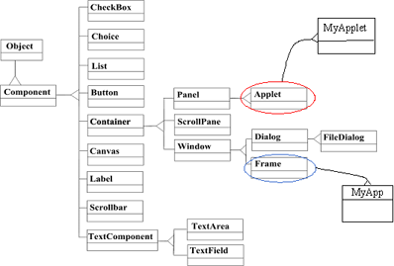
Component Class Hierarchy:
28

Slide 29
Adding Controls:
Steps to add a control to a container (Applet or Frame):
Create an instance of the desired control.
Add it to the container by calling the add method defined in Container class.
Component add(Component obj)
obj is the instance of the control.
Once a control is added, it will automatically visible on the container.
29

Slide 30
Removing Controls:
To remove a control, Container class defined a method:
void remove(Component obj)
30

Slide 31
Label:
Labels are passive controls that do not support any interaction with the user.
Label class Constructors:
Label( )
Label(String str)
Label(String str, int how)
str is the text of the Label
how specifies the alignment
Label.LEFT
Label.RIGHT
Label.CENTER
Methods:
void setText(String str)
String getText( )
void setAlignment(int how)
int getAlignment( )
31

Slide 32
Button:
A button (push button) is a component that contains a label and that generates an event when it is pressed.
Button class Constructors:
Button( )
Button(String str)
Methods:
void setLabel(String str)
String getLabel( )
32

Slide 33
AWT Controls:
Controls are components that allow a user to interact with our application.
The AWT supports the following types of controls:
Labels
Buttons
Check boxes
Choice lists
Lists
Scroll bars
Text editing
All these controls are subclasses of Component class.

Slide 34
Adding Controls:
Steps to add a control to a container (Applet or Frame):
Create an instance of the desired control.
Add it to the container by calling the add method defined in Container class.
Component add(Component obj)
obj is the instance of the control.
Once a control is added, it will automatically visible on the container.

Slide 35
Removing Controls:
To remove a control, Container class defined a method:
void remove(Component obj)

Slide 36
Label:
Labels are passive controls that do not support any interaction with the user.
Label class Constructors:
Label( )
Label(String str)
Label(String str, int how)
str is the text of the Label
how specifies the alignment
Label.LEFT
Label.RIGHT
Label.CENTER
Methods:
void setText(String str)
String getText( )
void setAlignment(int how)
int getAlignment( )

Slide 37
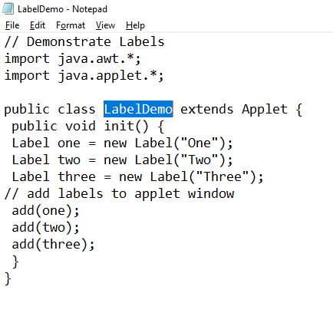
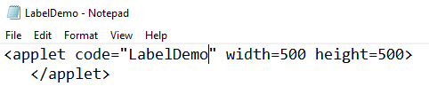

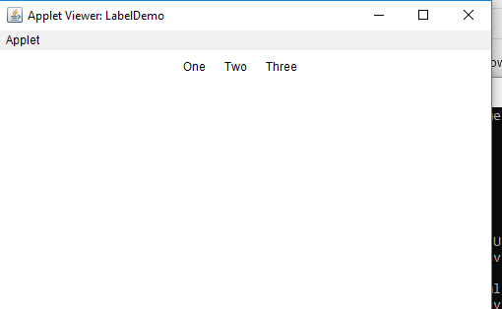

Slide 38
Button:
A button (push button) is a component that contains a label and that generates an event when it is pressed.
Button class Constructors:
Button( )
Button(String str)
Methods:
void setLabel(String str)
String getLabel( )

Slide 39
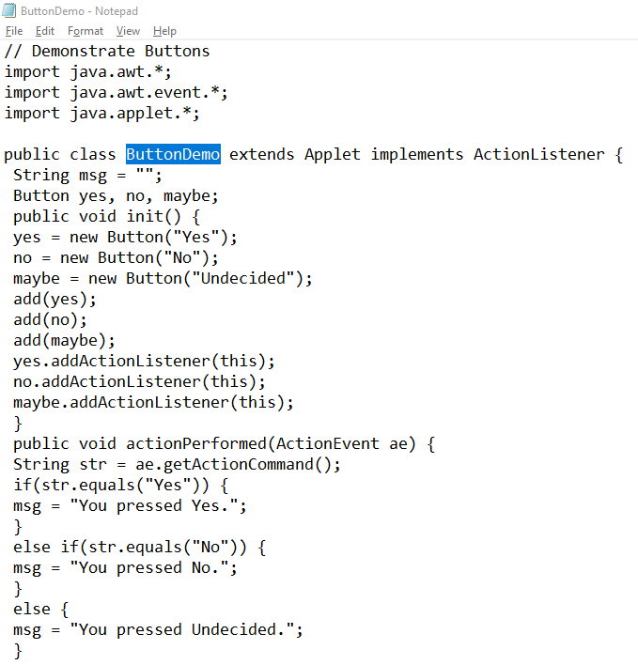
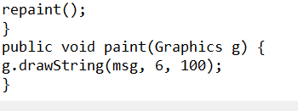
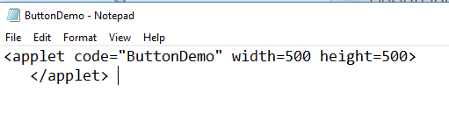
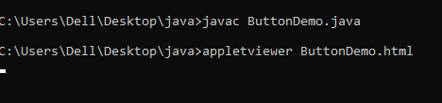
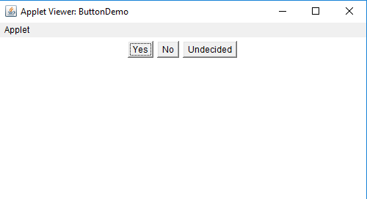

Slide 40
Checkbox:
A check box is a control that is used to turn an option on or off (check mark).
Each time a check box is selected or deselected, an item event is generated.
Checkbox class Constructors:
Checkbox( )
Checkbox(String str)
Checkbox(String str, boolean on)
Checkbox(String str, boolean on, CheckboxGroup cbg)
Checkbox(String str, CheckboxGroup cbg, boolean on)
Checkbox methods:
void setLabel(String str)
String getLabel( )
void setState(boolean on)
boolean getState( )
CheckboxGroup methods:
Checkbox getSelectedCheckbox( )
void setSelectedCheckbox(Checkbox cb)

Slide 41
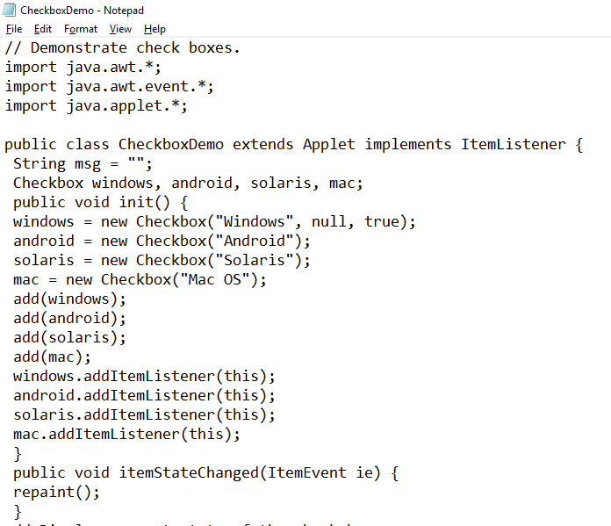
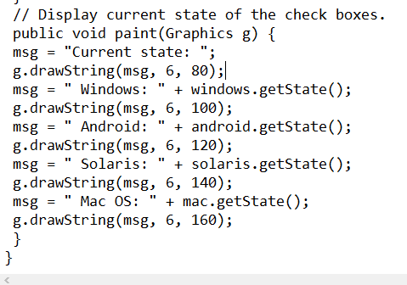
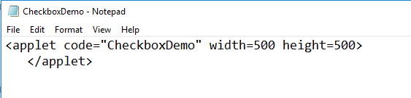

Slide 42

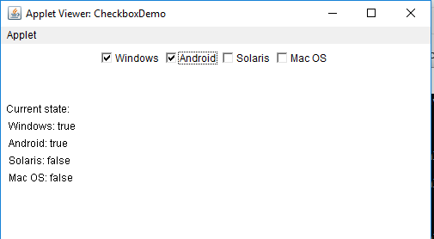

Slide 43
Choice:
The Choice is used to create a pop-up list of items.
Each time a choice is selected, an item event is generated.
Choice class contains only the default constructor.
Choice methods:
void addItem(String name)
void add(String name)
String getSelectedItem( )
int getSelectedIndex( )
int getItemCount( )
void select(int index)
void select(String name)
String getItem(int index)

Slide 44
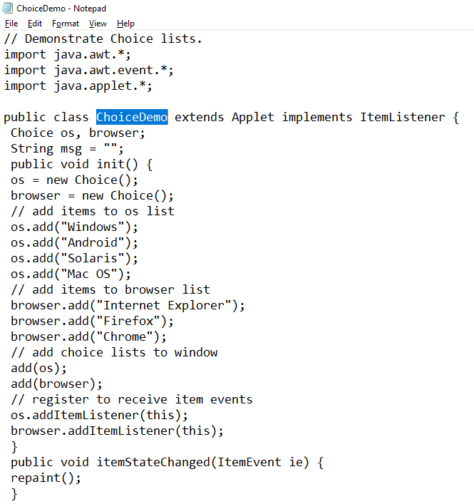
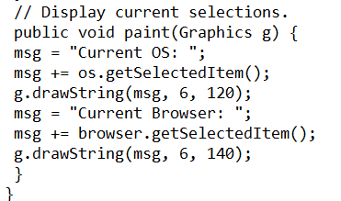
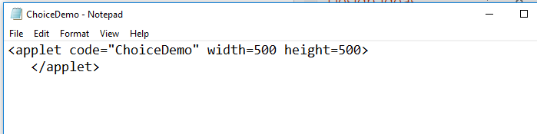

Slide 45

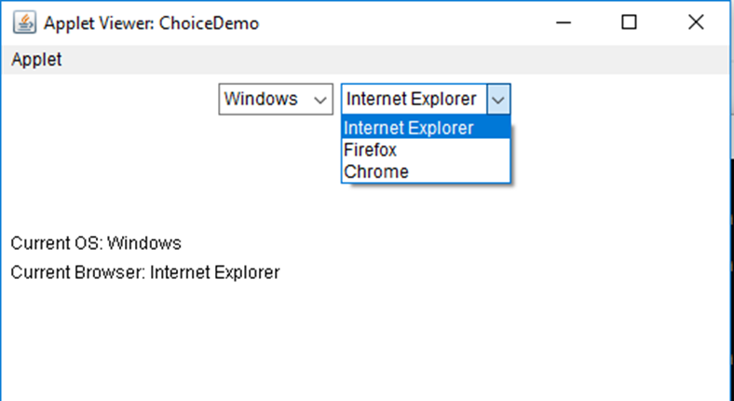

Slide 46
List:
The List provides a compact, multiple-choice, scrolling selection list.
A list shows a number of choices in the visible widow. It also allow multiple selections.
List constructors:
List( )
List(int numRows)
List(int numRows, boolean multipleSelect)
List methods:
void add(String name)
void add(String name, int index)
String getSelectedItem( )
int getSelectedIndex( )
String[ ] getSelectedItems( )
int[ ] getSelectedIndexes( )
int getItemCount( )
void select(int index)
String getItem(int index)

Slide 47
List:
Each time an item in the list is selected or deselected with a single click, an item event is generated.
When a list item is double-clicked, an action event is generated.

Slide 48
Scrollbar:
Scrollbars are used to select continuous values between a specified minimum and maximum.
Scrollbar constructors:
Scrollbar( )
Scrollbar(int style)
Scrollbar(int style, int initialValue, int thumbSize, int min, int max)
Style can be,
Scrollbar.VERTICAL
Scrollbar.HORIZONTAL
Scrollbar methods:
void setValues(int initialValue, int thumbSize, int min, int max)
int getValue( )
void setValue(int newValue)
int getMinimum( )
int getMaximum( )
void setUnitIncrement(int newIncr)
void setBlockIncrement(int newIncr)

Slide 49
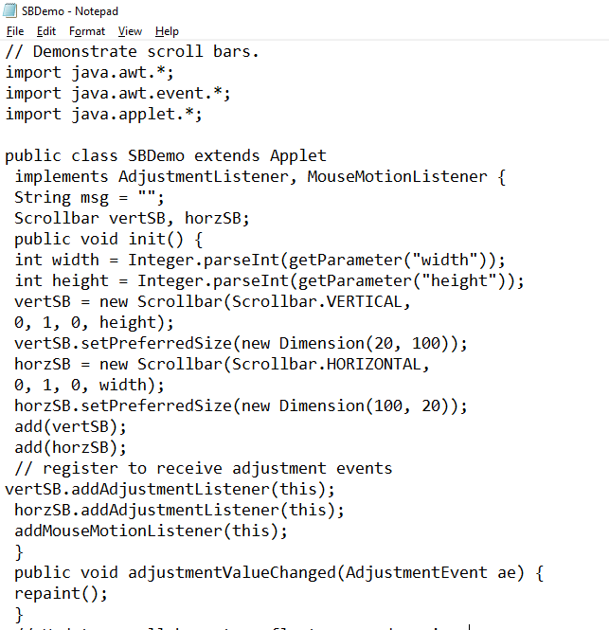
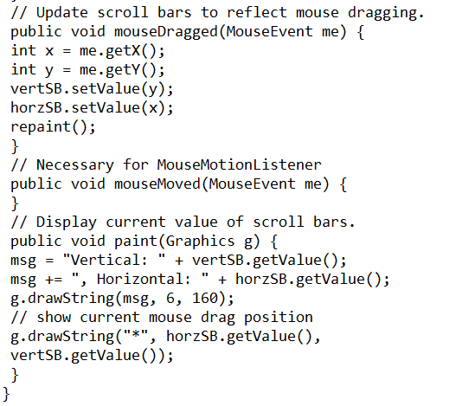
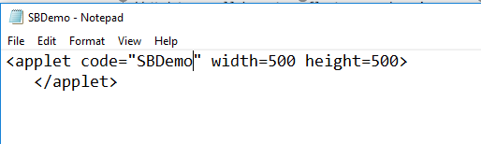

Slide 50
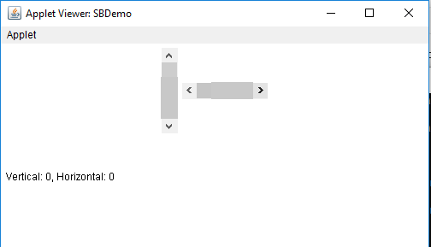

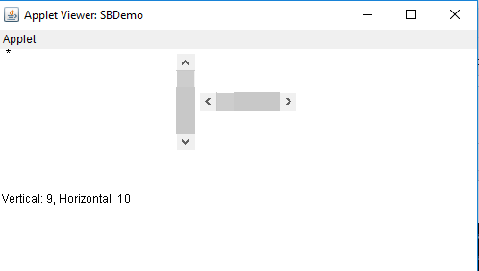

Slide 51
TextField:
TextField is a single line text entry area. TexField is subclass of TextComponent.
TextField constructors:
TextField( )
TextField(int numChars)
TextField(String str)
TextField(String str, int numChars)
TextField methods:
String getText( )
void setText(String str)
String getSelectedText( )
void select(int startIndex, int endIndex)
boolean isEditable( )
void setEditable(boolean canEdit)
int getSelectionStart( )
int getSelectionEnd( )
void setEchoChar(char ch)
boolean echoCharIsSet( )
char getEchoChar( )

Slide 52
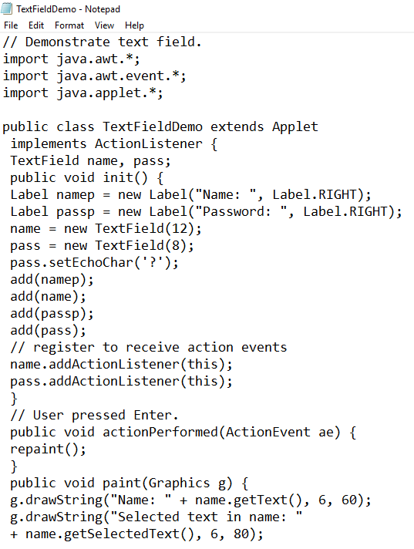

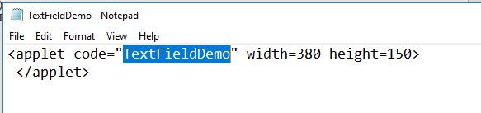

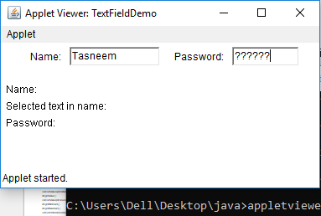

Slide 53
TextArea:
TextArea is a multiline editor. TextArea is subclass of TextComponent.
TextArea constructors:
TextArea( )
TextArea(int numLines, int numChars)
TextArea(String str)
TextArea(String str, int numLines, int numChars)
TextArea(String str, int numLines, int numChars, int scrBars)
scrBars can be
SCROLLBARS_BOTH
SCROLLBARS_NONE
SCROLLBARS_HORIZONTAL_ONLY
SCROLLBARS_VERTICAL_ONLY

Slide 54
TextArea:
TextArea methods:
String getText( )
void setText(String str)
String getSelectedText( )
void select(int startIndex, int endIndex)
boolean isEditable( )
void setEditable(boolean canEdit)
int getSelectionStart( )
int getSelectionEnd( )
void append(String str)
void insert(String str, int index)
void replaceRange(String str, int startIndex, ine endIndex)

Slide 55
Menu Bars and Menus:
Menus in Java are implemented by the use of the following classes:
MenuBar
Menu
MenuItem
CheckboxMenuItem
To create a menu bar, just create an instance on MenuBar class.
MenuBar class defines only the default constructor.

Slide 56
Menu:
Constructors:
Menu( )
Menu(String optionName)
Menu(String optionName, boolean removable)
MenuItem:
Constructors:
MenuItem( )
MenuItem(String itemName)
MenuItem(String itemName, MenuShortcut keyAccel)

Slide 57
CheckboxMenuItem:
Constructors:
CheckboxMenuItem( )
CheckboxMenuItem(String itemName)
CheckboxMenuItem(String itemName, boolean on)
MenuShortcut:
Constructors:
MenuShortcut(int key)
MenuShortcut(int key, boolean useShiftMidifier)

Slide 58
Layout Managers:
A layout manager is used by a container to position each of the components with in it.
Each container has a layout manager associated with it.
A layout manager is an instance of any class that implements the interface LayoutManager.
The layout manager is set by:
void setLayout(LayoutManager layoutObj)
Java defines the following layout manager classes:
1. FlowLayout
2. BorderLayout
3. GridLayout
4. CardLayout
5. GridbagLayout

Slide 59
FlowLayout:
FlowLayout is the default layout manager.
With this components are laid out from the upper-left corner, left to right and top to bottom line by line.
Constructors:
FlowLayout( )
FlowLayout(int how)
FlowLayout(int how, int horz, int vert)
Valid how values are
FlowLayout.LEFT
FlowLayout.CENTER
FlowLayout.RIGHT

Slide 60
import java.awt.*;
import javax.swing.*;
public class MyFlowLayout{
JFrame f;
MyFlowLayout(){
f=new JFrame();
JButton b1=new JButton("1");
JButton b2=new JButton("2");
JButton b3=new JButton("3");
JButton b4=new JButton("4");
JButton b5=new JButton("5");

Slide 61
f.add(b1);f.add(b2);f.add(b3);f.add(b4);f.add(b5);
f.setLayout(new FlowLayout(FlowLayout.RIGHT));
//setting flow layout of right alignment
f.setSize(300,300);
f.setVisible(true);
}
public static void main(String[] args) {
new MyFlowLayout();
}
}

Slide 62
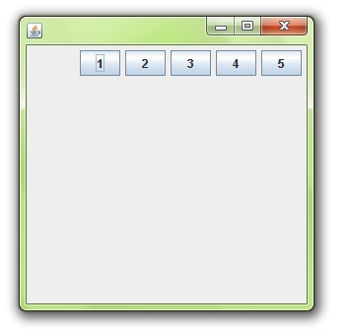

Slide 63
BorderLayout:
With BorderLayout, a conatiner has four narrow fixed-width components at the edges and one large are in the center. The four sides are referred to as north, south, east and west. The middle area is called the center.
Constructors:
BorderLayout( )
BorderLayout(int horz, int vert)
To add components use the following add method:
void add(Component compObj, Object region)
The region can be
BorderLayout.CENTER
BorderLayout.EAST
BorderLayout.WEST
BorderLayout.NORTH
BorderLayout.SOUTH

Slide 64
import java.awt.*;
import javax.swing.*;
public class Border {
JFrame f;
Border(){
f=new JFrame();
JButton b1=new JButton("NORTH");;
JButton b2=new JButton("SOUTH");;
JButton b3=new JButton("EAST");;
JButton b4=new JButton("WEST");;
JButton b5=new JButton("CENTER");;

Slide 65
f.add(b1,BorderLayout.NORTH);
f.add(b2,BorderLayout.SOUTH);
f.add(b3,BorderLayout.EAST);
f.add(b4,BorderLayout.WEST);
f.add(b5,BorderLayout.CENTER);
f.setSize(300,300);
f.setVisible(true);
}
public static void main(String[] args) {
new Border();
}
}

Slide 66
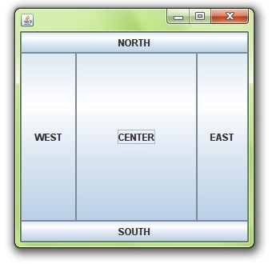

Slide 67
GridLayout:
GridLayout lays out components in a two-dimensional grid.
Constructors:
GridLayout( )
GridLayout(int numRows, int numColumns)
GridLayout(int numRows, int numColumns, int horz, int vert)

Slide 68
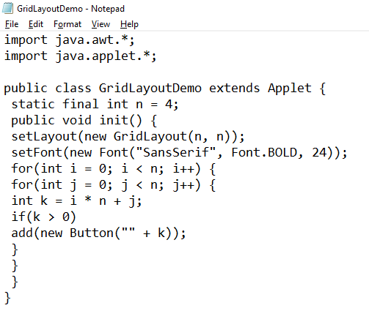
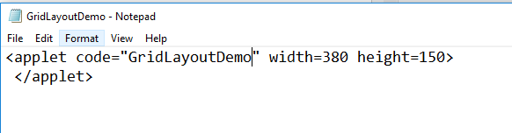
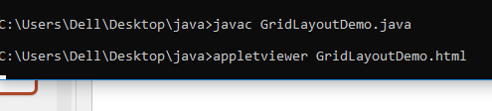
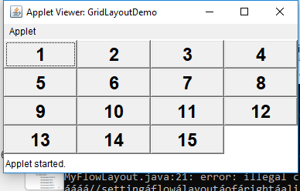

Slide 69
CardLayout
The CardLayout class is unique among the other layout managers in that it stores several different layouts. Each layout can be thought of as being on a separate index card in a deck that can be shuffled so that any card is on top at a given time. This can be useful for user interfaces with optional components that can be dynamically enabled and disabled upon user input.
CardLayout( )
CardLayout(int horz, int vert)
void add(Component panelRef, Object name)
void first(Container deck)
void last(Container deck)
void next(Container deck)
void previous(Container deck)
void show(Container deck, String cardName)

Slide 70
GridBagLayout
Although the preceding layouts are perfectly acceptable for many uses, some situations will require that you take a bit more control over how the components are arranged. A good way to do this is to use a grid bag layout
you can specify the relative placement of components by specifying their positions within cells inside a grid. The key to the grid bag is that each component can be a different size, and each row in the grid can have a different number of columns. This is why the layout is called a grid bag

